Slide 1
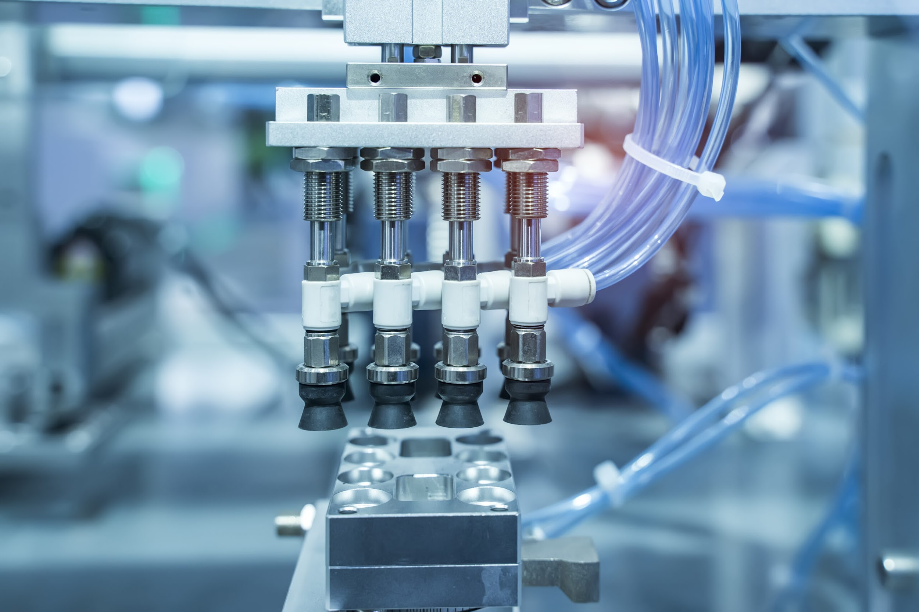



Design And Development Of AI/ML Based Intelligent Fault Detection System For Industrial Hydraulic Systems
Faculty Advisor: Prof. Ajit Kumar

Slide 2
Overview
Flow of presentation
Mathematical Modeling of Healthy and Faulty system
Virtual Model and Experimental model Based Working proof
Machine Learning based Algorithm for fault identification
Results and discussion

Slide 3
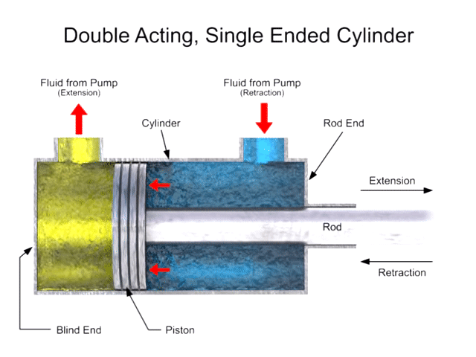
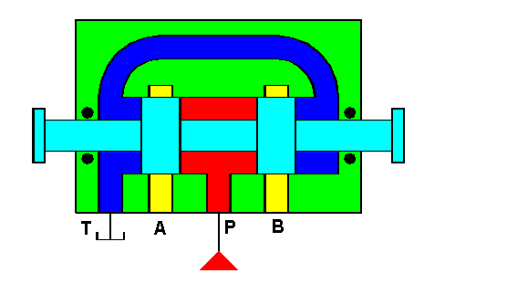
Internal Leakage Fault
Valve Spool Blockage Fault

Slide 4
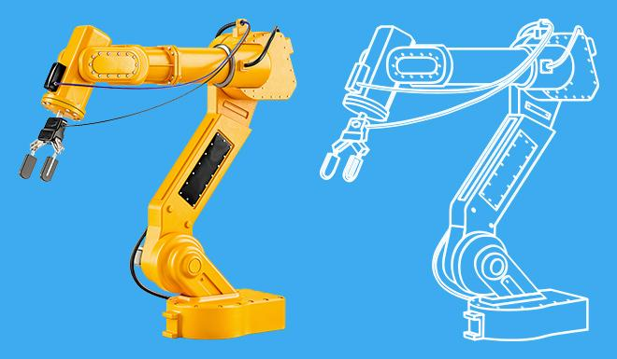
Topic 1 : Digital Twin Model
Simulation allows you to explore 'what if' questions and scenarios without having to experiment on the system itself.
It helps you to gain insight into which variables are most important to system performance.
Conditions can be varied and outcomes investigated.
Critical situations can be investigated without risk and it is cost effective.
Software used for Virtual Simulation:
Automation Studio(Internal Leakage Fault)
MATLAB-SIMULINK(Valve Spool Blockage)

Slide 5
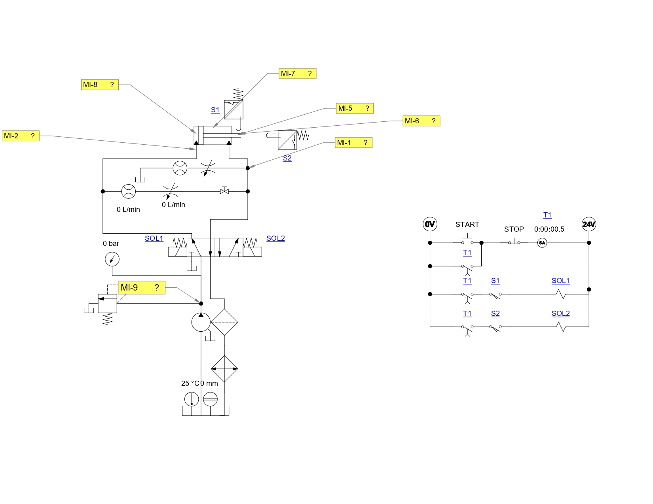
Virtual Model In Automation Studio

Slide 6
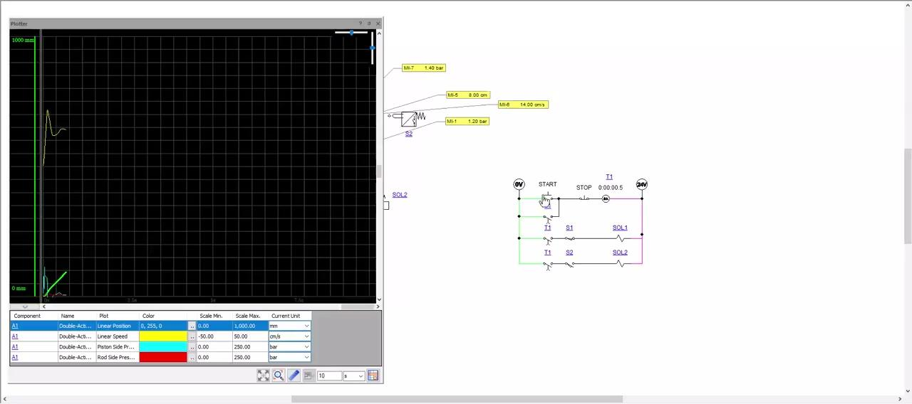
Simulation-Virtual Model

Slide 7
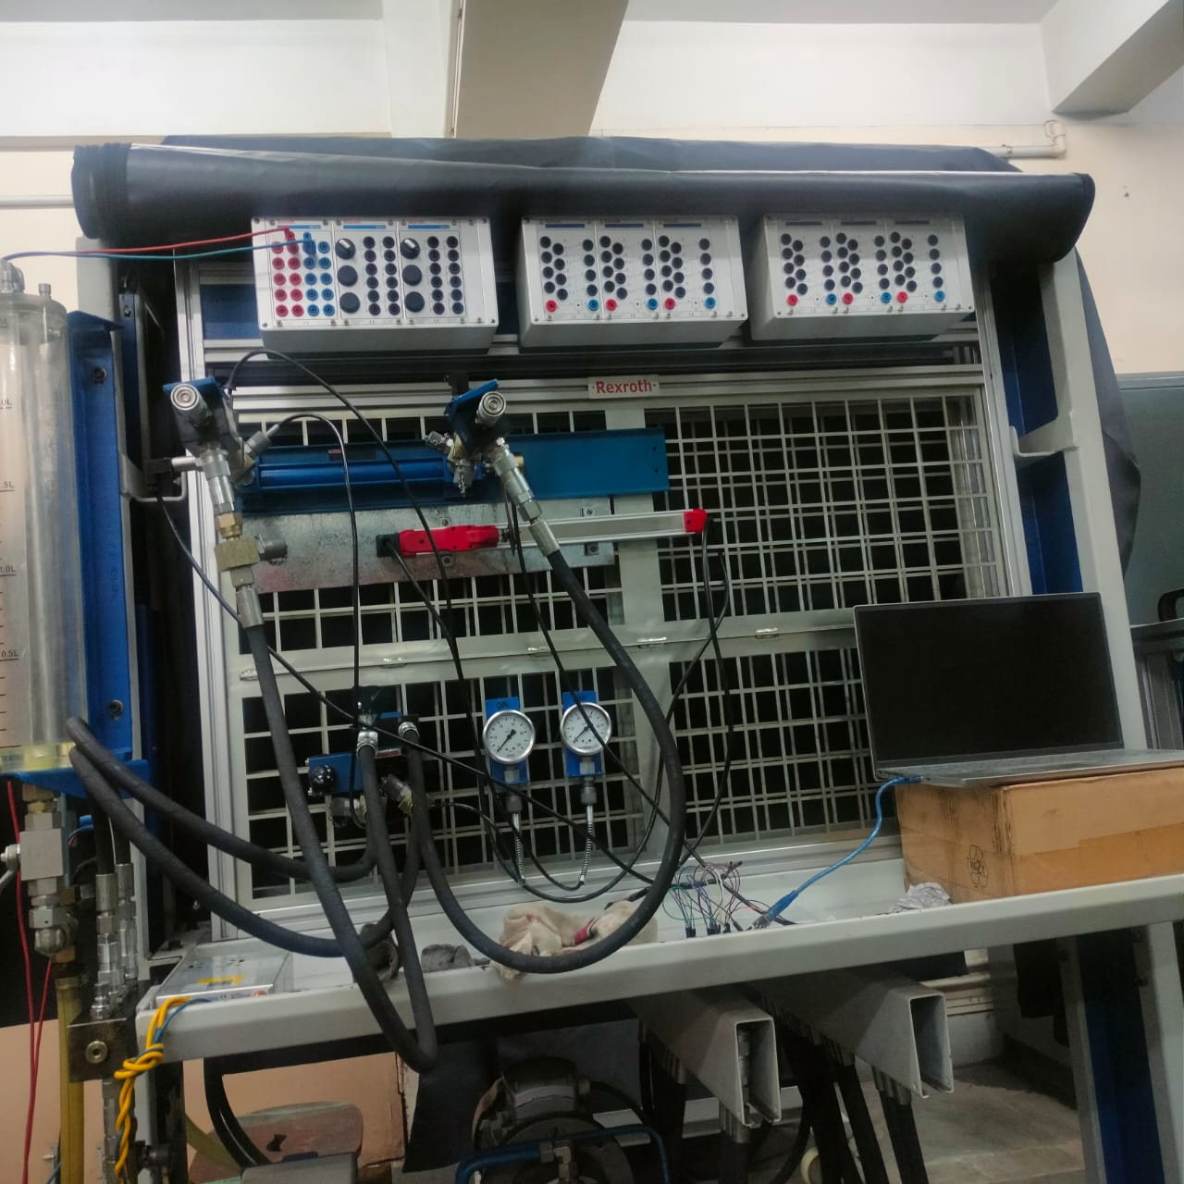
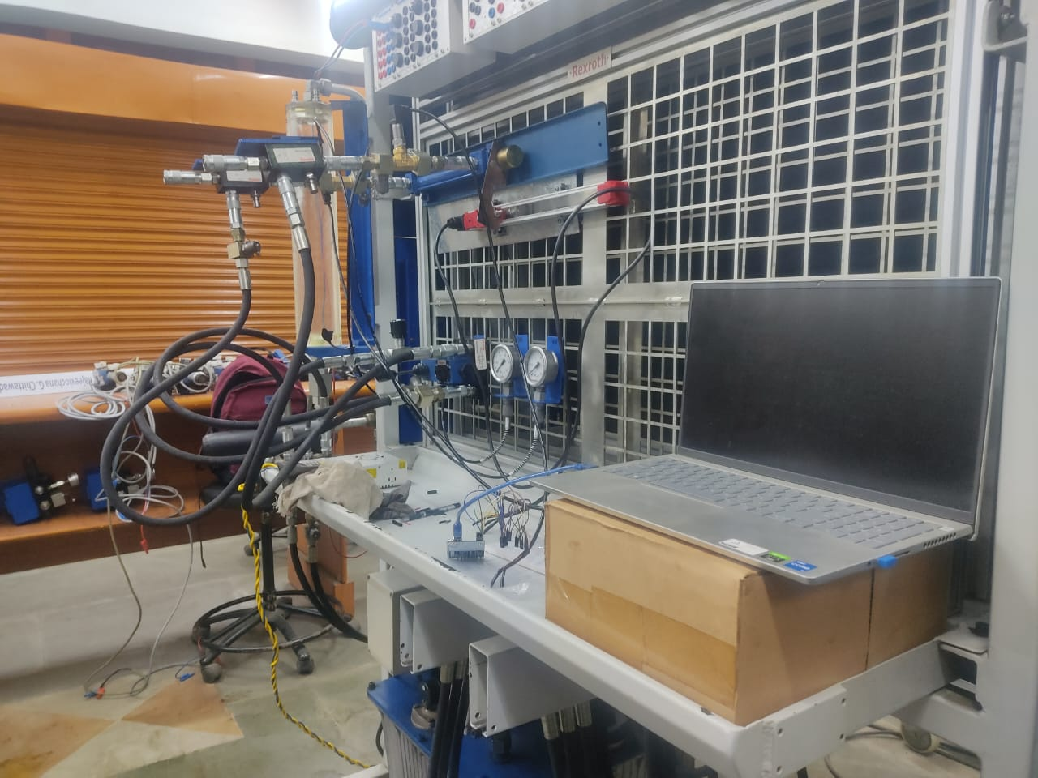
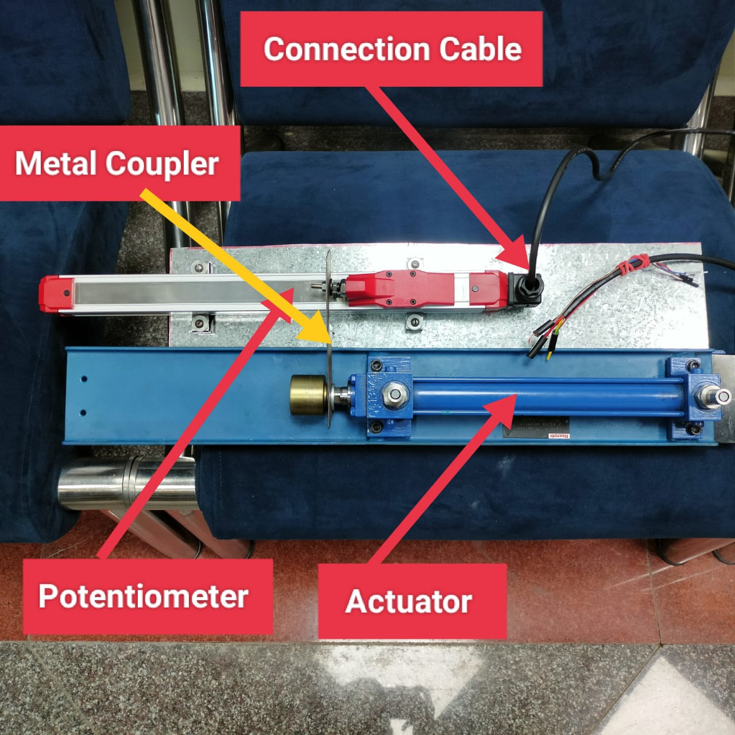
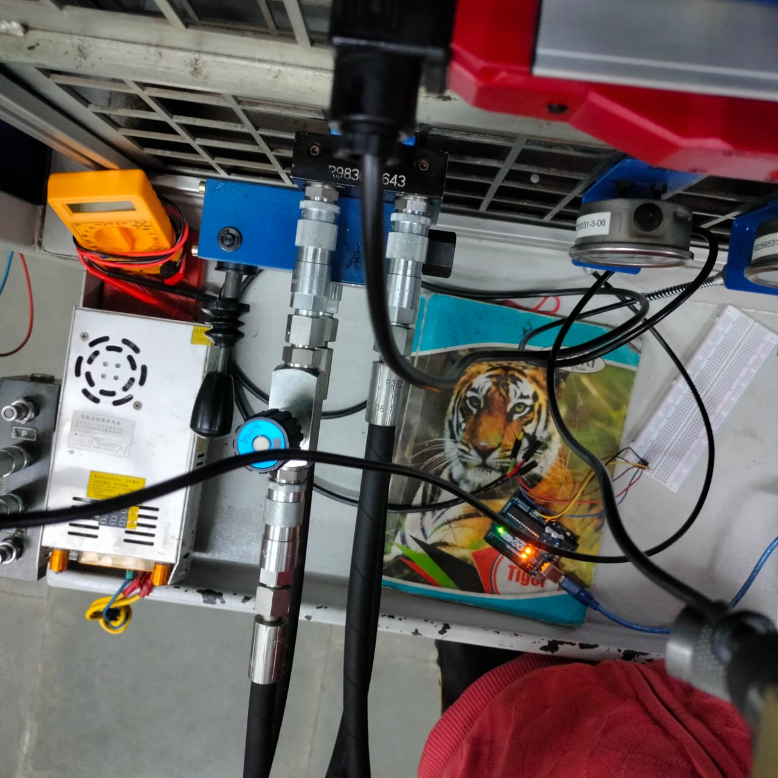
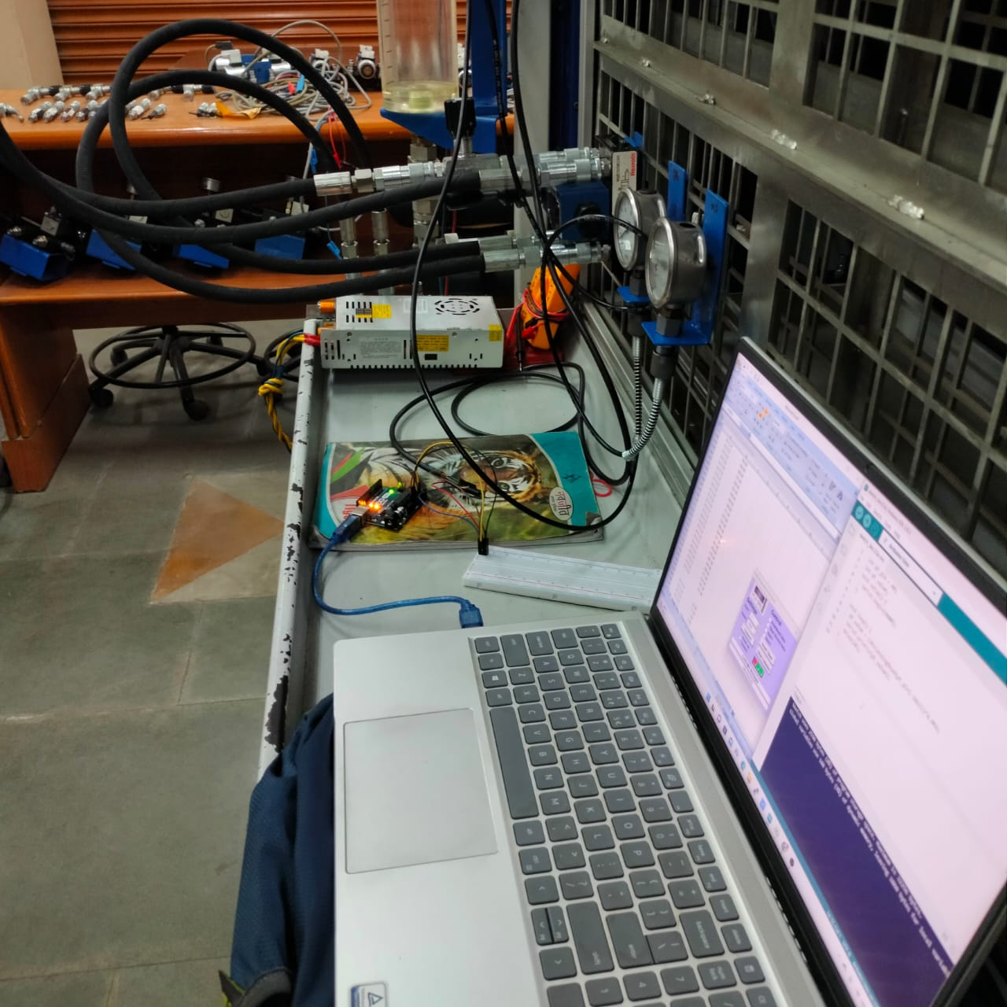
Experimental Test Rig

Slide 8
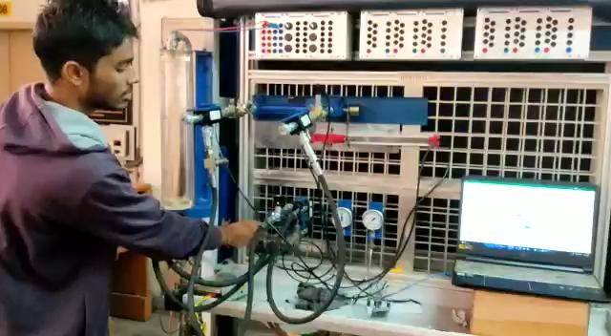
Experimental Test Rig

Slide 9
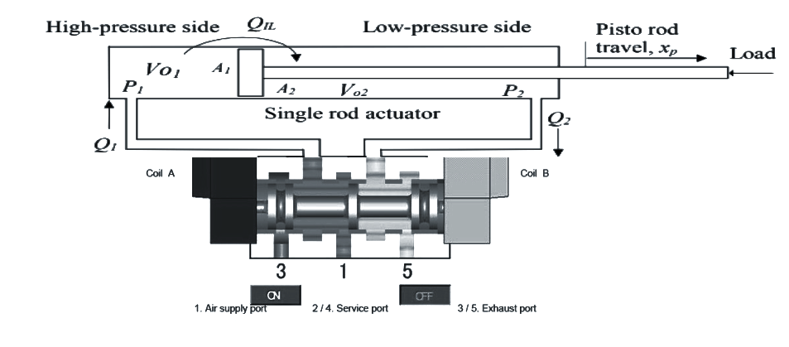
2
4

Slide 10
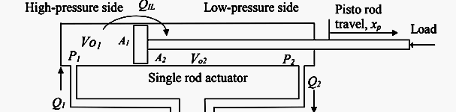
Mathematical Modelling of Oil Leakage Fault
Following assumptions are considered :
The fluid properties are not changed, i.e. the effective bulk modulus βe and the density of the fluid ρ are constant.
The supply and exit pressures are constant(Pe and Ps), both valve and actuator parameters are constant.
And the valve orifices are assumed matched and symmetrical. It is also assumed that the line dynamics and losses are negligible, i.e., P₁= P_{s} and P₂= P_{e}.

Slide 11
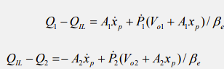
Mathematical Modelling of Faults
Applying Continuity Equation
On Subtracting Eq. (2) from Eq. (1), We get :
Here, Q₁ = flow rate at high pressure side
Q₂ = flow rate at low pressure side
Q_{IL}= Internal oil leakage flow rate
- -(1)
- -(2)
- -(3)

Slide 12
V01 and V02 are initial volume of oil in cap end and rod end respectively.
A₁ and A₂ are areas of piston head from cap end and rod end respectively.
X_{p} = displacement of piston rod
Ẋ_{p} = velocity of piston rod

Slide 13
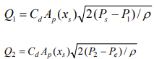
Mathematical Modelling of Faults
Assuming negligible losses through ports P₁ and P₂
Here,
C_{d} = Valve discharge coefficient or Flow coefficient
A_{p} = Valve port area corresponding to travel x_{s}.
Substituting (4) in (3)
- -(4)
- -(5)

Slide 14
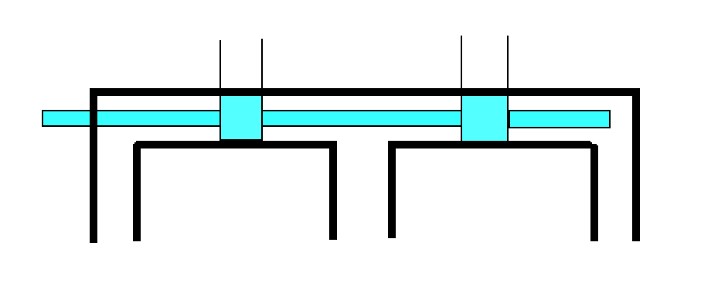
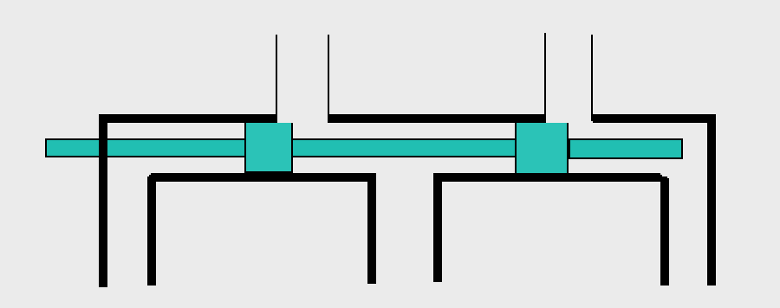
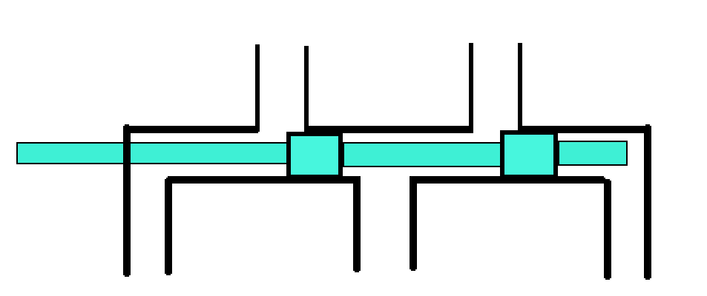
P_{s}
P_{e}
P_{e}
P_{s}
P_{e}
P_{e}
Centre Position
Parallel Position with controlled Spool Movement
P_{e}
P_{s}
P_{e}
Cross Position with controlled Spool Movement

Slide 15
FAULT INDICES
Fault indices are the dimensionless parameters that define the fault and its severity. The values of the fault indices will be outputs of the ANN based fault Detection System.
For internal oil leakage across actuation
a₁ = Q_{IL}/Q₁
For valve spool blockage fault:
a₂ = x_{s}/s_{s}
a₁ and a₂ are fault indices of internal leakage and valve spool blockage respectively.

Slide 16
FAULT INDICES Continued..
Q_{IL} is amount of leakage flow rate in actuator chamber.
S_{s} is total stroke of valve spool.
The value of all faults indices are between 0 and 1 according to the fault severity.
a₁ = 0 for healthy system and gradually increases with fault intensity.
a₂ = 1 for healthy system and gradually decreases with fault intensity.

Slide 17
Experiments : Classification and Conditions
Experiment Condition and its Classification |  | Fault Indices
Usage | Classification | a1 | a2
For training the ANN based FDS | Healthy | 0 | 0
 |  | 0 | 0
 |  | 0 | 0
 | Internal leakage fault | 0.14 | 0
 |  | 0.36 | 0
 |  | 0.42 | 0
 | Valve spool blockage fault | 0 | 0.5
 |  | 0 | 0.63
 |  | 0 | 0.75
For testing the ANN based FDS | Healthy | 0 | 0
 | Internal leakage fault | 0.44 | 0
 | Valve spool blockage fault | 0 | 0.25

Slide 18
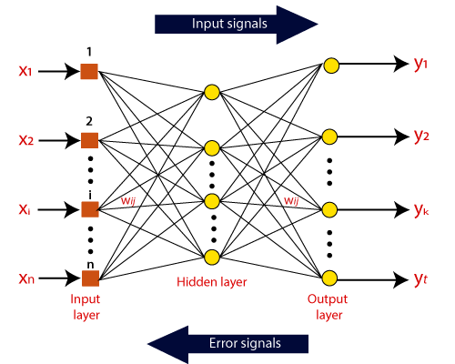
ARTIFICIAL NEURAL NETWORK
"Artificial Neural Network" is derived from Biological neural networks that develop the structure of a human brain. Similar to the human brain that has neurons interconnected to one another, artificial neural networks also have neurons that are interconnected to one another in various layers of the networks. These neurons are known as nodes.

Slide 19
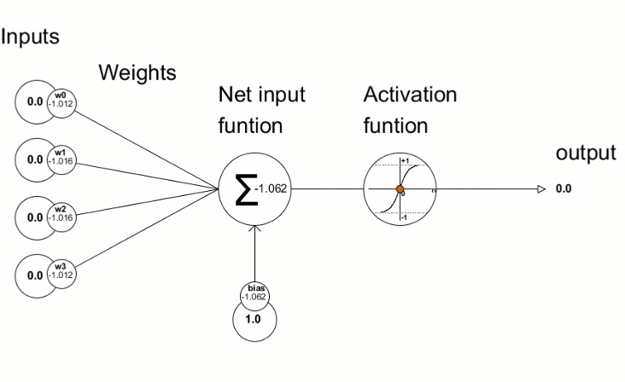
NEURAL NETWORK ARCHITECTURE
Learning Process is initiated by three steps
Training dataset – This dataset allows the Neural Network to understand the weights between nodes.
Validation dataset – This dataset is used for fine-tuning the performance of the Neural Network.
Test dataset – This dataset is used to determine the accuracy and margin of error of the Neural Network.

Slide 20
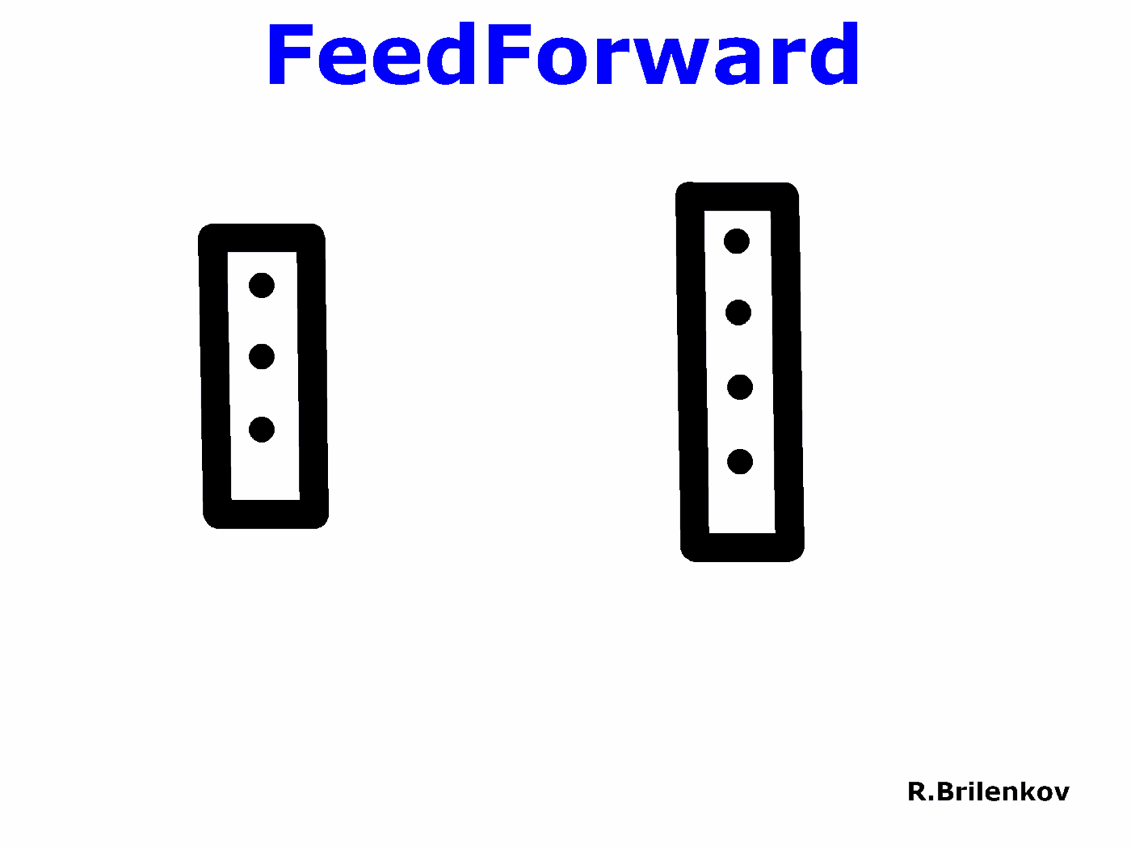
FEED - FORWARD ALGORITHM (NO FEEDBACK)
The signals in a feed forward model only move in one way, to the output layer. With zero or more hidden layers, to feed in the forward direction of the network mechanism in order to have have one input layer and one single output layer.

Slide 21
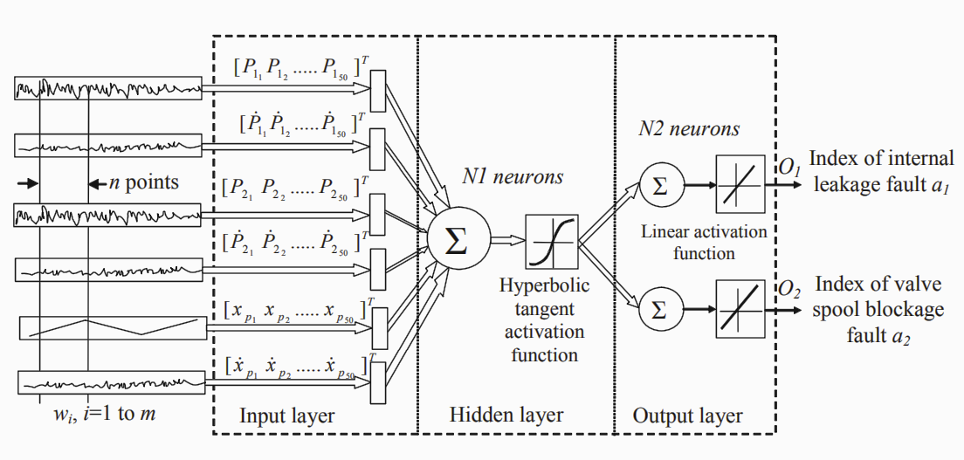
ARCHITECTURE OF THE OVERALL FAULT DIAGNOSTIC SYSTEM USING ANN

Slide 22
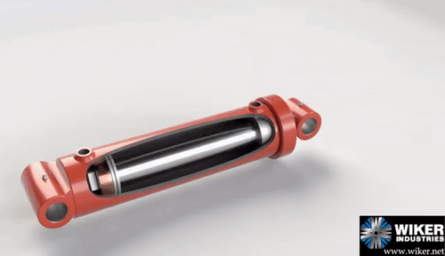
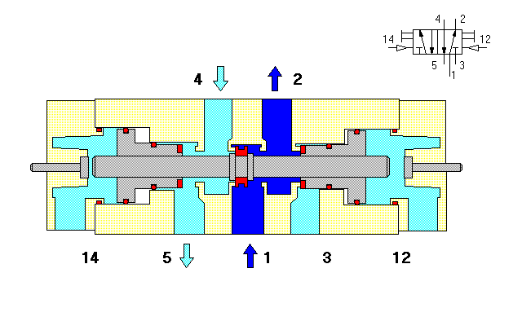
Design of the ANN-Based Fault Diagnostic System
The ANN based FDS performs pattern recognition in such that it classifies the input data vectors to different categories according to fault types. This leads to achieve the detection and isolation of the hydraulic power system faults. The ANN based FDS works in two modes sequentially:
the training mode
the fault diagnostic mode.

Slide 23
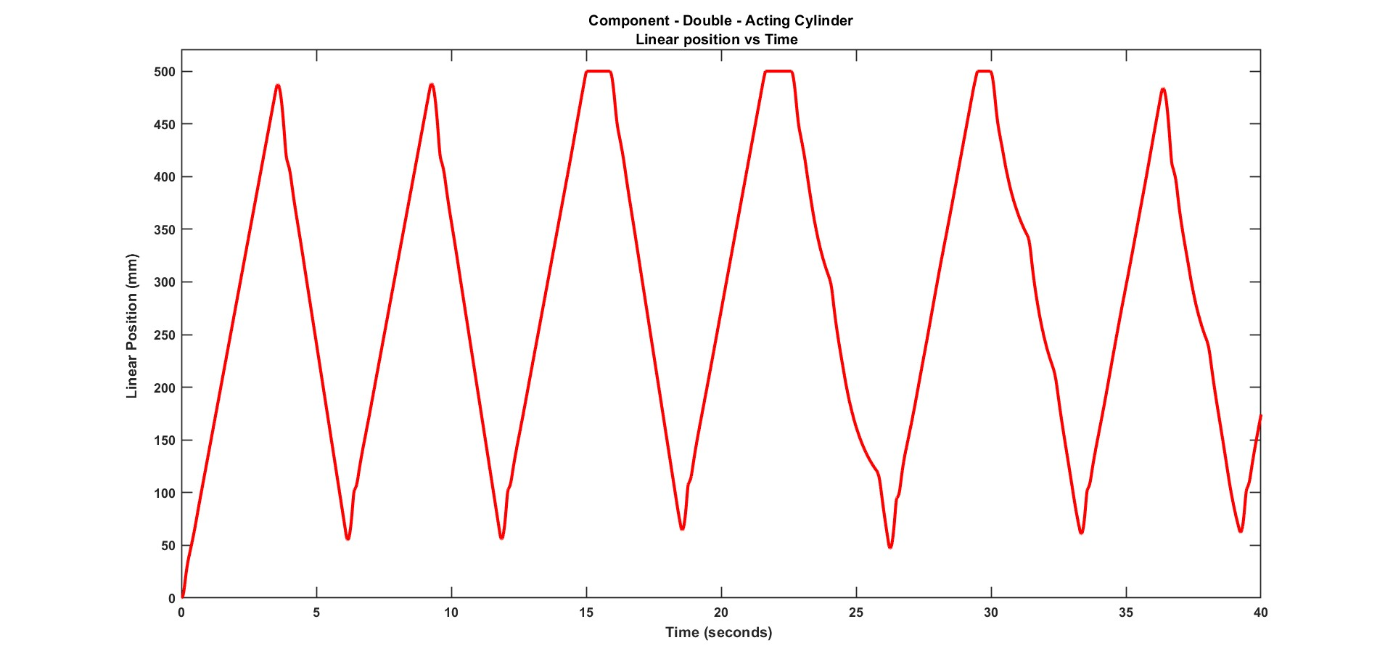
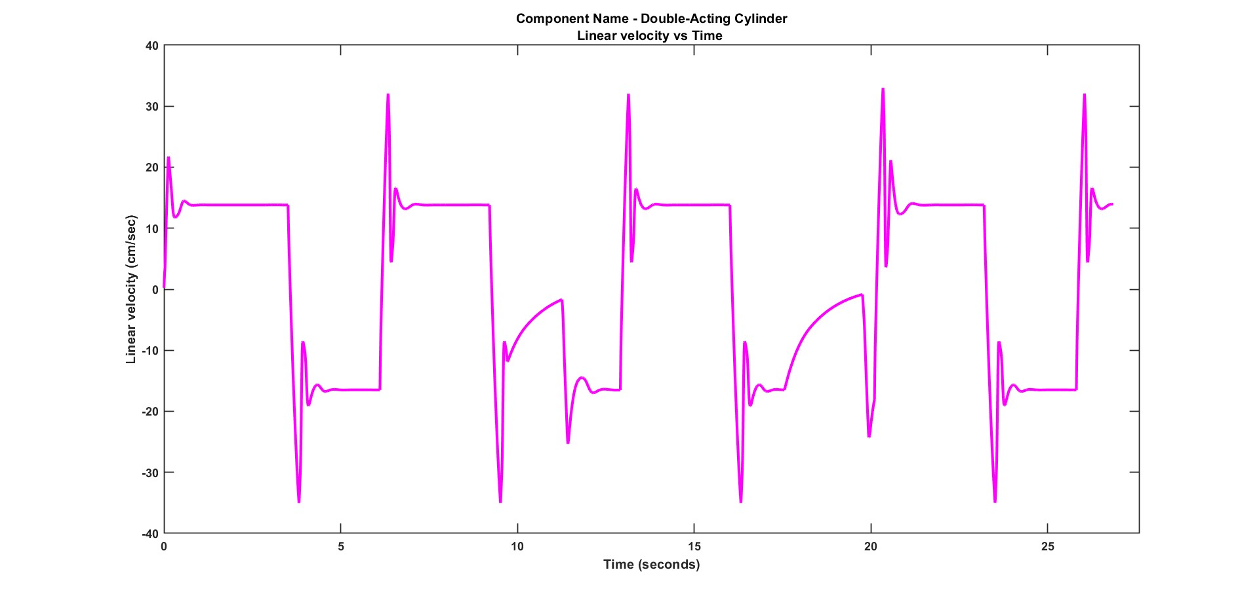
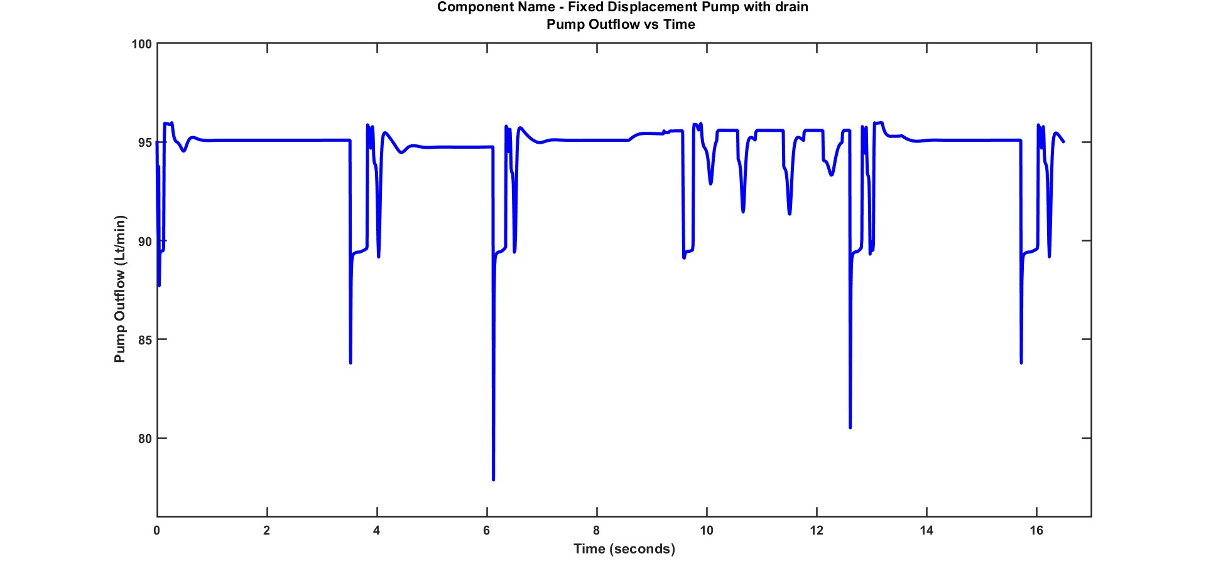
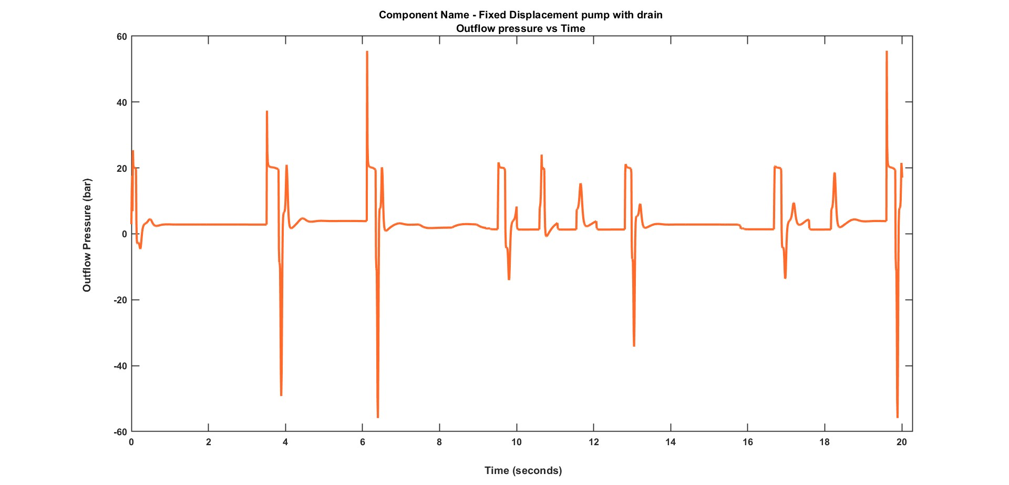
Results and Analysis

Slide 24
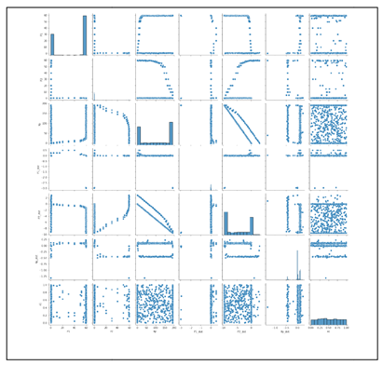
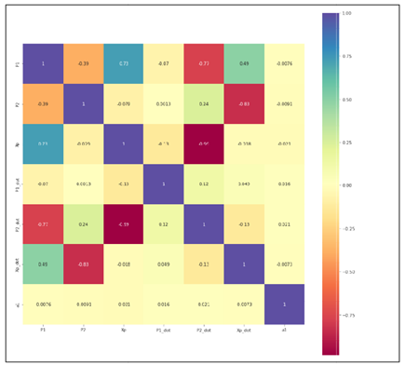
Analysis of Fault Diagnosis

Slide 25
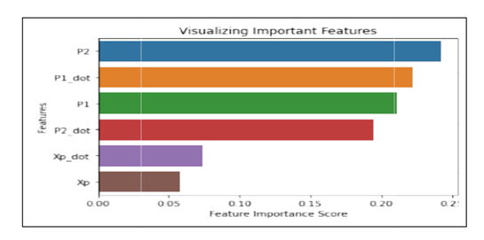
Analysis of Fault Diagnosis

Slide 26
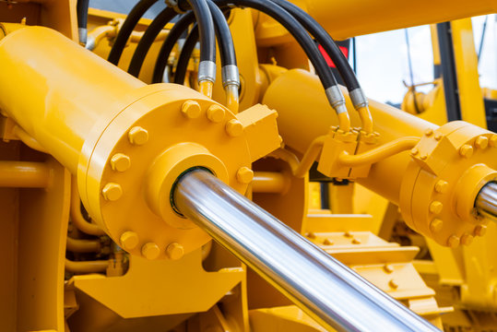
Thank You

